Slide 1

Valentine’s Day Storytime
Kendralyn Burr

Slide 2
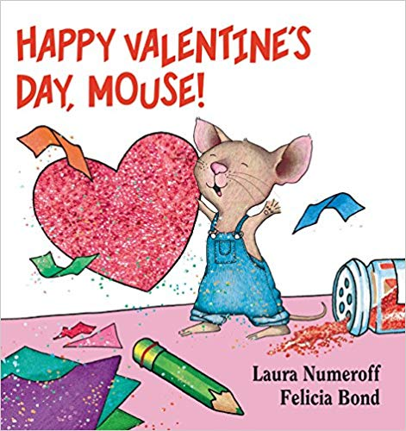
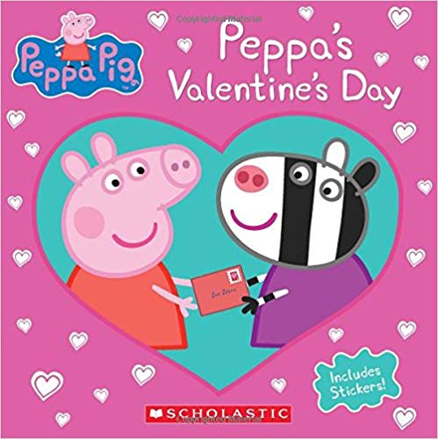
Storytime Timeline:
Opening Rhyme: “I Have a Little Heart”
Read Book 1: Happy Valentine’s Day, Mouse!
Read Book 2: Peppa’s Valentine’s Day
Craft: Valentine’s Day Cookie Bar
Closing Rhyme: “The Goodbye Train is Leaving”
Theme: Valentine’s Day
Audience: Preschool Children Ages 3 - 5
Notes:
I have chosen to do a Storytime at a public library during school hours. The theme for this Storytime is Valentine’s Day. This theme was chosen because the holiday is coming up. The audience for the Storytime are preschool children ages 3 – 5.
Here we have the timeline for the Storytime session. We will start the Storytime by gathering in a circle and singing a song titled “I Have a Little Heart”. The song can be found on the next slide. After the first song, we will read Book 1: Happy Valentine’s Day, Mouse!. Book 2: Peppa’s Valentine’s Day will follow. After reading, we will transition to a craft table which will have an assortment of cookies (regular and gluten free), along with items to decorate the cookies. After craft time, we will finish the session by singing our closing rhyme titled “The Goodbye Train is Leaving”. This song can be found on the next slide as well.
Book 1 was chosen because it directly reflects the theme. It has 24 pages and is perfect for preschoolers. The book will introduce Valentine’s Day to the children as we follow Mouse as he makes Valentines for each of his friends. Book 2 directly reflects the theme as well. It too has 24 pages and has a reading level of 3 -5 years. This book follows Peppa as she learns about the meaning of Valentine’s Day and friendships.
Each image was found on Amazon and links can be found below:
Book 1: https://www.amazon.com/dp/0061804320/?coliid=I1RQ2X0889IZUP&colid=1N6NTVCKTQ5YL&psc=0&ref_=lv_ov_lig_dp_it
Book 2: https://www.amazon.com/dp/133815897X/?coliid=I8FKJFX9MXZ9J&colid=1N6NTVCKTQ5YL&psc=0

Slide 3
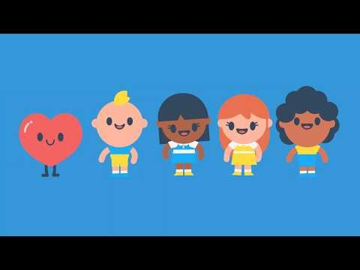
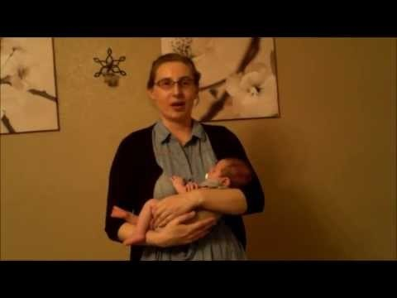
Finger Rhymes
“I Have a Little Heart”
“The Goodbye Train is Leaving”
Notes:
Here are two videos of the two songs. Both songs can use different hand gestures or movements and can be repeated multiple times. They are both very simple and age appropriate. I personally love these songs and think that they are a great addition to the Storytime.
The first song was chosen to relate to the Valentine’s Day theme. The second song was chosen as a simple fun way to close the session.
Please click on each video separately to watch. If you are unable to view using the video, I have provided a link to each for you to view.
“I Have a Little Heart” link: https://youtu.be/J9QeCrgZRIA
“The Goodbye Train is Leaving” link: https://youtu.be/I3lDiLI50RA

Slide 4
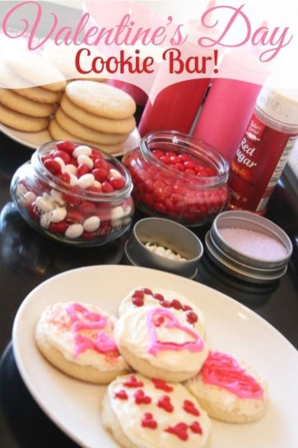
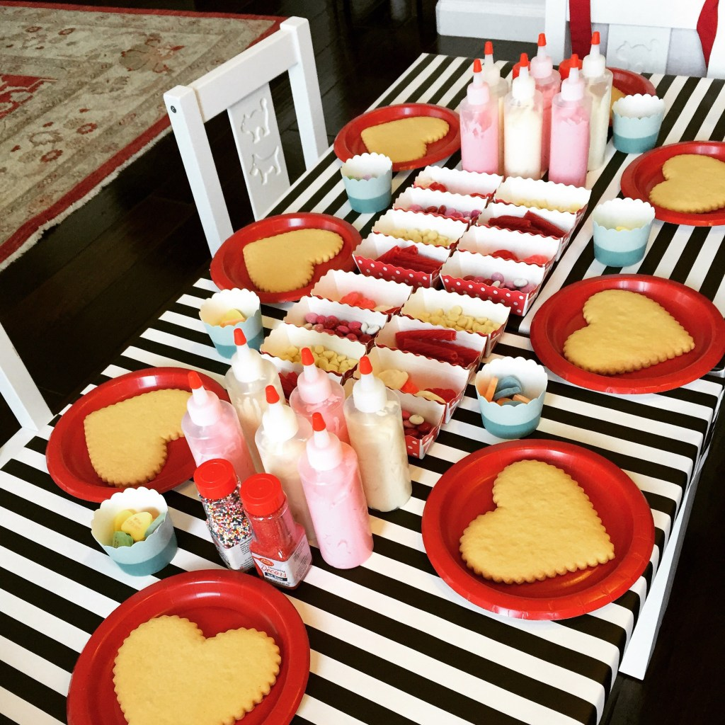
Craft: Valentine’s Day Cookie Bar
Notes:
The craft for the Storytime session is a Valentine’s Day Cookie Bar. Here we will have a table display with different types of cookies. In addition to the cookies, we will have edible decorations to add to the cookies such as frosting, sprinkles, candy, and more. We will also have drinking water nearby. This will provide the children with a fun craft and a snack.
I found both of these images on Pinterest and they both display similar ideas for how I would set up the craft table.
First picture: https://www.pinterest.com/pin/218002438199136382/
Second picture: https://www.pinterest.com/pin/218002438199136372/
Thank you for viewing my presentation.

